Slide 1
B.L.D.E Association’s Comm, B.H.S Arts & T.G.P Science College JAMKHANDI :Department of BCA:
Project Associates :
Priyanka Kallimath
Rashmi Sonar
Prashant Sindhur
Under the Guidance :
Mr. P.V.Tilavalli
Mr. V.N.Tubachi

Slide 2
Objective
Online ordering system that I am proposing here, greatly simplifies the ordering process for the customer. System presents an interactive and up-to-date menu with all available options in an easy to use manner. Customer can choose one or more items to place an order which will land in the Cart. Customer can view all the order details in the cart before checking out. At the end, customer gets order confirmation details

Slide 3
Features
Online menus (original and searchable format)
Easy lookup of restaurants in your area
Simple, fast and convenient ordering of food
Accurate – no more spelling out the dishes’ names.

Slide 4
Advantages
Reduce time-consuming phone orders
No more busy phones or the requirement for extra phone lines.
Broader customer reaches across regions.
Builds a customer database.
Helps in improved service.
Greater customer satisfaction!!!

Slide 5
Modules of the Project
Admin Module
Customer Module

Slide 6
ADMIN Module:
Admin having the all the privileges over the project.
He can add the items in the menus. So that customer can be viewed and put a order.
He can delete, update, view the items.
He can add the new Offers. So that customer can be view and place a order.
He can delete, update, view the items.
He can view the Ordered list of the customer.
He can view the orders who have cancel the orders.

Slide 7
Customer Module:
Customer can resister and use the web
application.
He can view the new offers and place an order.
He can search the items and place order
apart from new offer.
He can give a feed back and can view the
feed back in main page.
If He want to cancel the order the he can cancel
order within half an hour.

Slide 8
Usecase Diagram Of Admin:
Log In
New item insertion
New offer creation
View Ordered List
Admin
View Cacled Order list
Log Out

Slide 9
Usecase Diagram of customer:
Log in
Place Order
Cancel Order
Feed Back
New Offer view and place Order
customer
Log Out

Slide 10
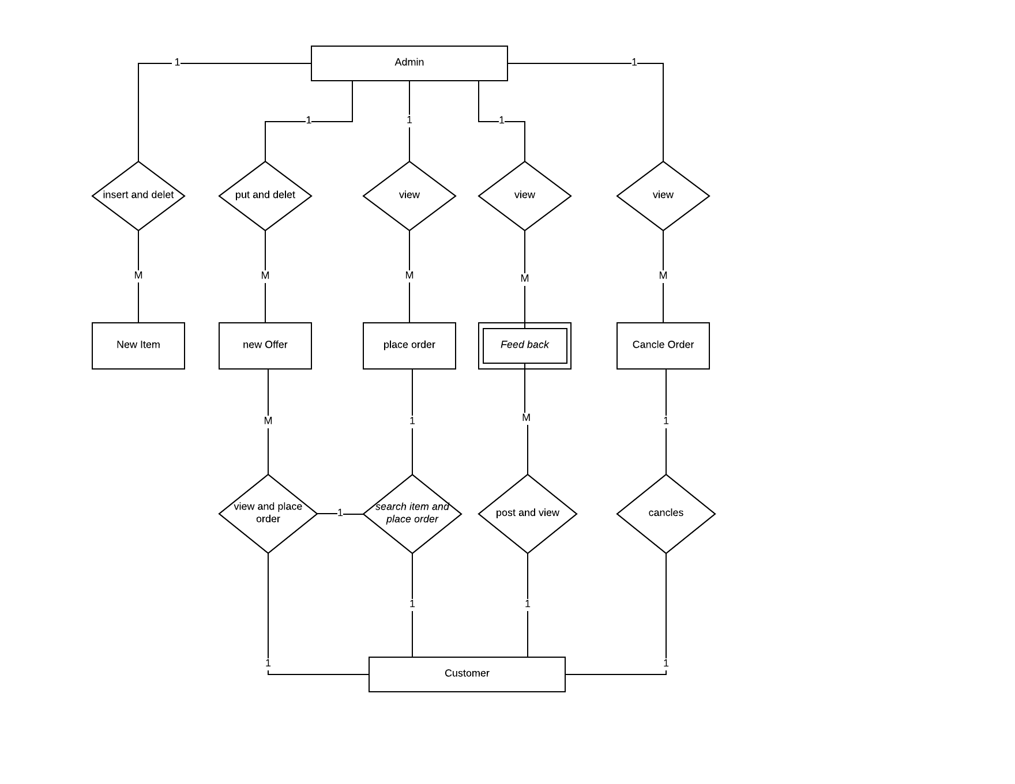
ER-Diagram

Slide 11
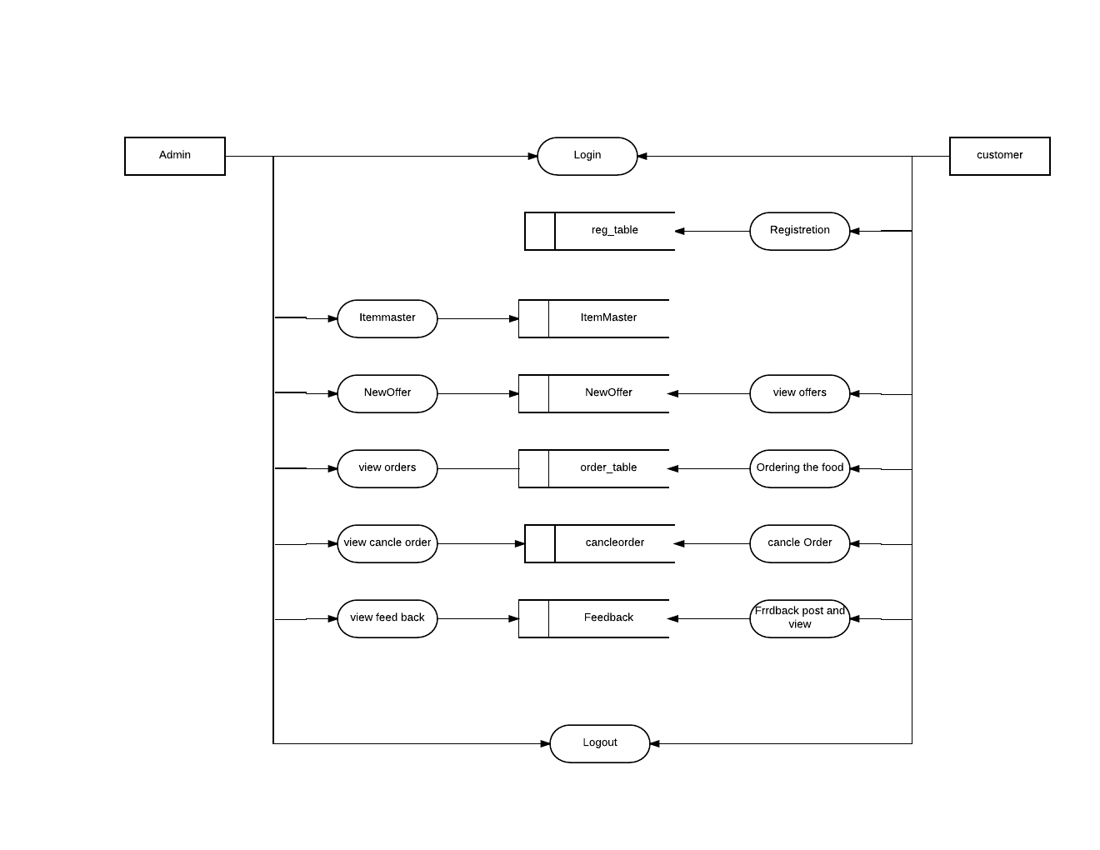
DFD Diagram

Slide 12
Hardware Requirements Specification
Operating System : Windows 7 on words
IDE: Visual Studio 2010 or above
Design: ASP.NET, HTML, CSS, Framework 3.5
DBMS SQL Server 2005
Other Tools: Microsoft Office, Visual Paramedic

Slide 13
Software Requirements Specification
Processor : Pentium IV
RAM : 2GB
Hard Disk Drive : 30MB
LAN Cable
Inter Connection Requirement
LAN Driver
Optical Mouse
Standard USA Layout Keyboard
Monitor: color 15inch

Slide 14
Limitation
Customer can’t order the food before the day. It’s only for a present day.
Customer can’t cancel the food after a half an hour.

Slide 15
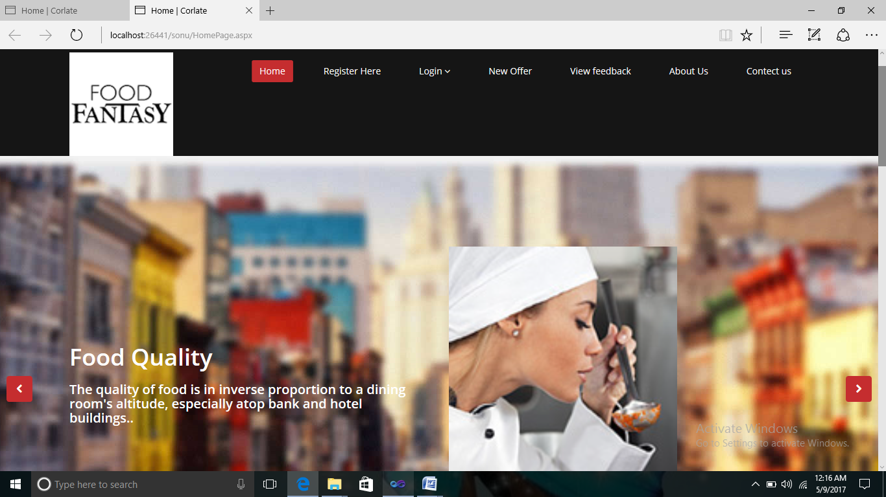
Homepage

Slide 16
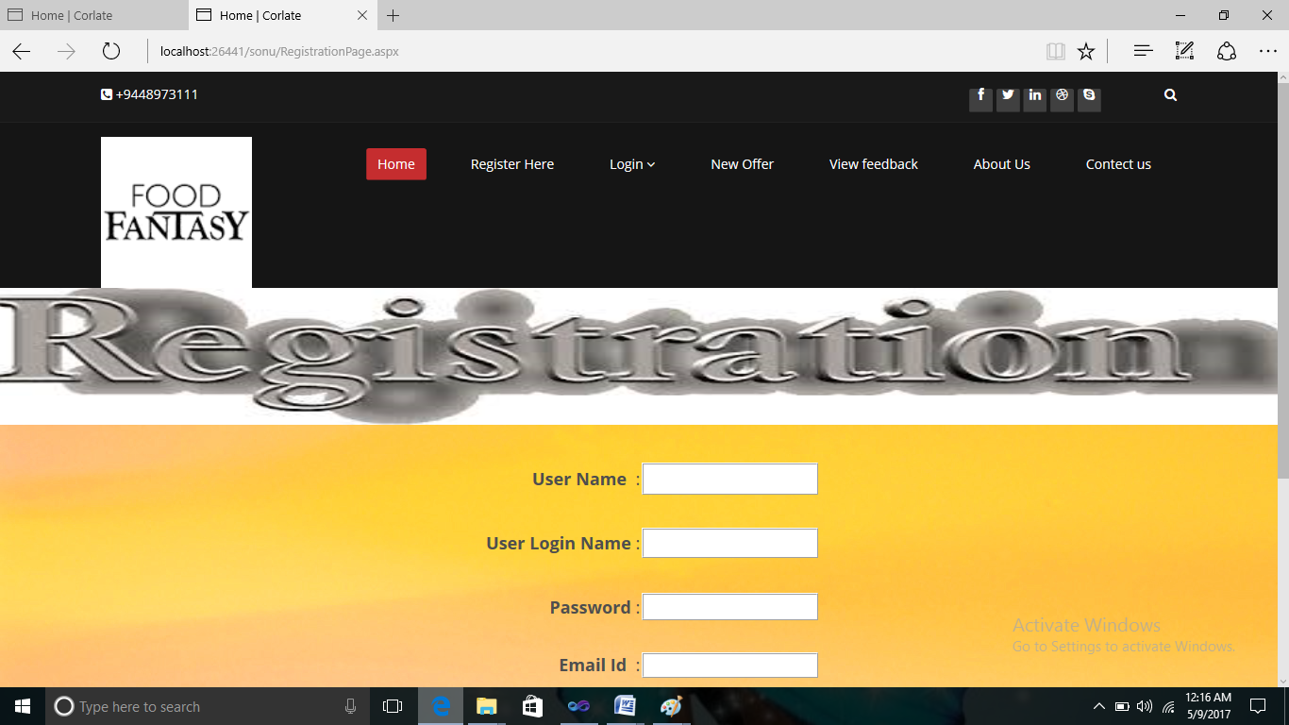
Registration Page

Slide 17
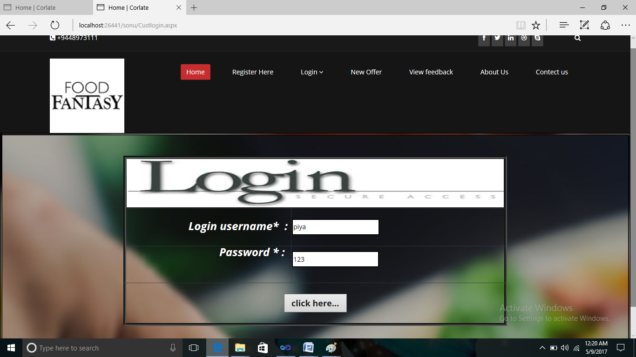
Login Page

Slide 18
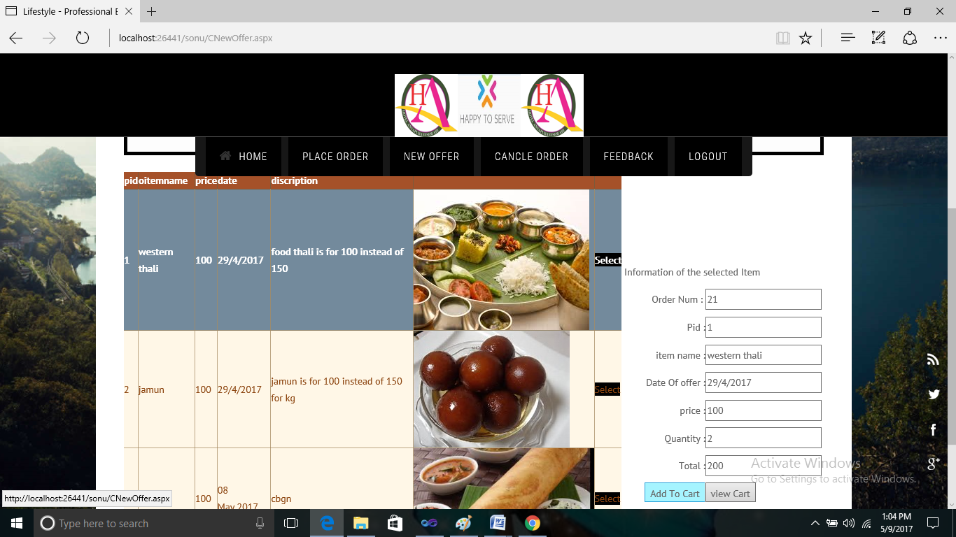
PlaceOrder page

Slide 19
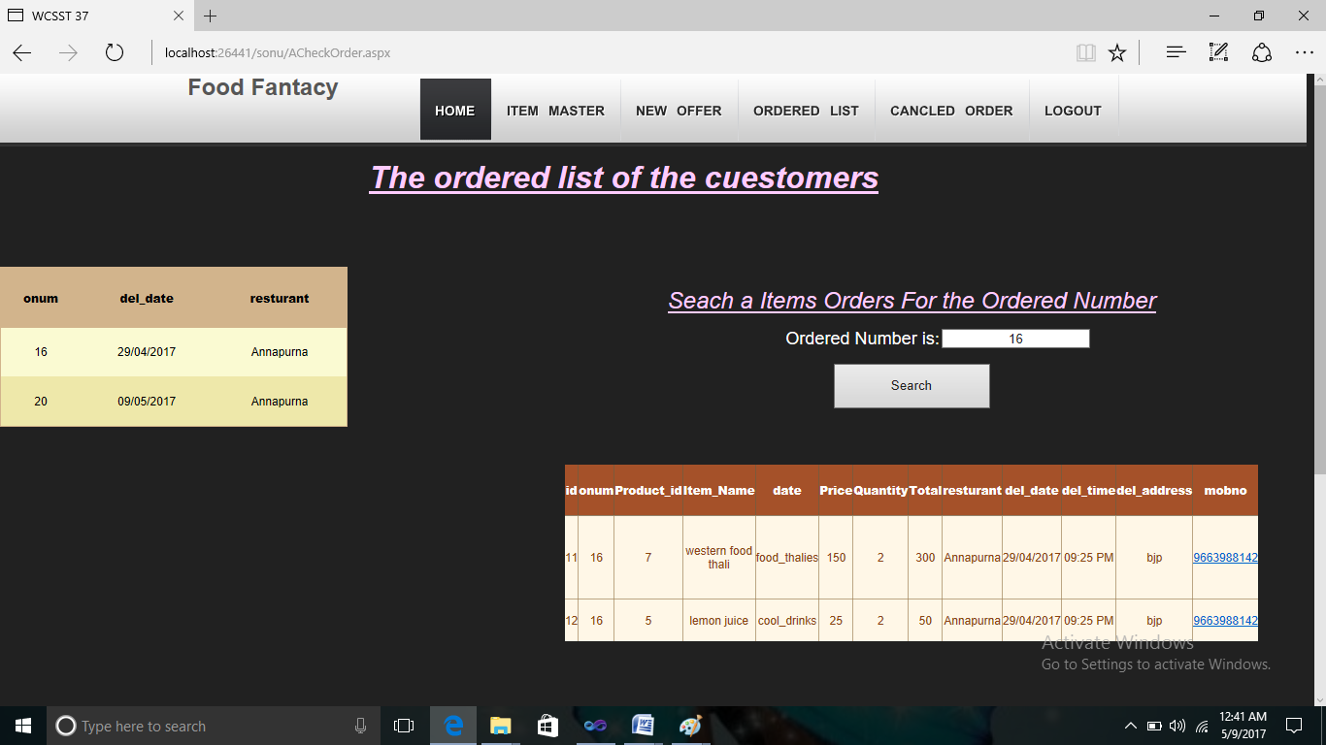
Ordered list

Slide 20
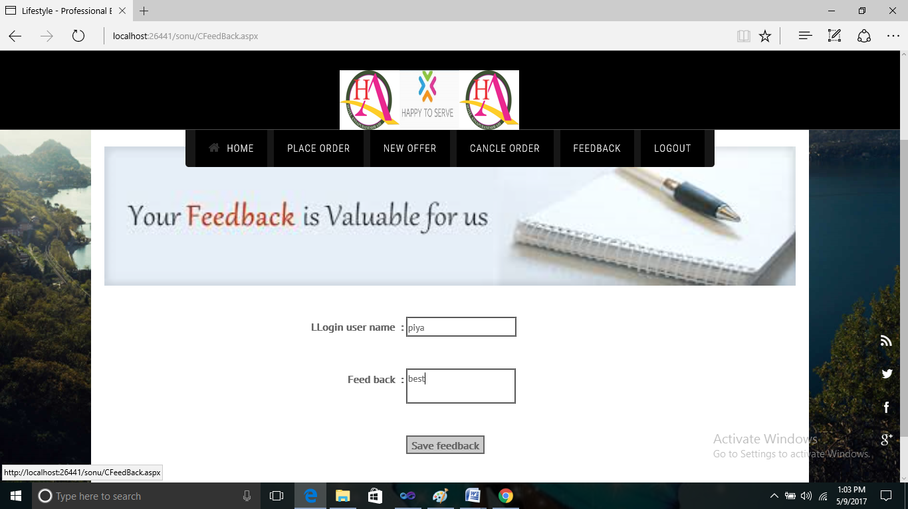
Feedback page

Slide 21
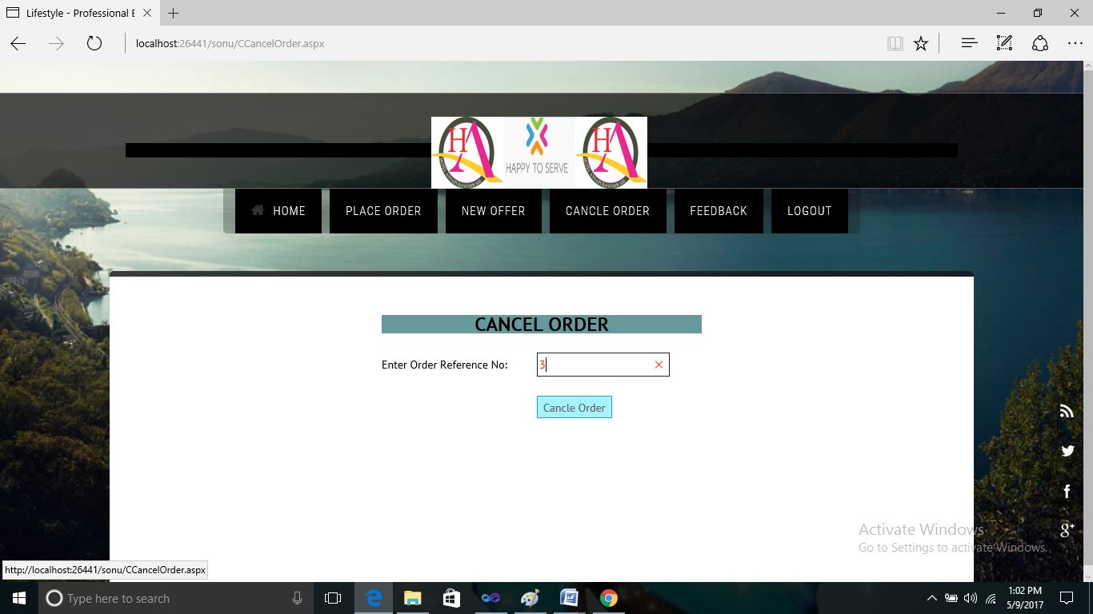
Cancel Order Page

Slide 22
THANK YOU

